Slide 1


Bitcoin
Bitcoin
What Makes it Secure?
Jason Follas Sr. Software Engineer Quicken Loans
@jfollas

Slide 2
Bitcoin: What makes it secure?
Bitcoin is a cryptocurrency, but what does that mean? How is mathematics used to protect your Bitcoins and your identity? What is the long-term outlook for the level of cryptography that is used by Bitcoin before anyone with commodity hardware can crack the codes? This session attempts to answer those questions while providing a primer of how cryptographic hashing algorithms and elliptic curve digital signature algorithms work, and how they have been broken in the past.

Slide 3
Why this Presentation?
I am a long-time Cryptocurrency enthusiast
I wanted to prove to myself that my investments in Crypto were secure
Disclaimer: This material has nothing to do with my day job.*
* Although, it has proven useful to know about the concepts that will be discussed!

Slide 4
Warning
Lots of material to cover in the next hour
Lots of slides
Lots of Math Formulas
This talk is structured for awareness, not comprehension
This slide deck will be made available for offline consumption

Slide 5
So, Why Learn About Bitcoin?
55:00

Slide 6
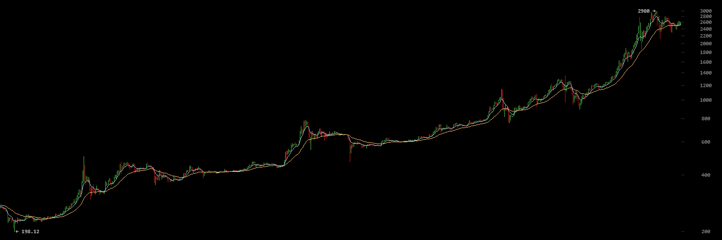
2 Years Growth

Slide 7



Blockchain

Slide 8
Quick Primer on Cryptography
Cryptography is the study and methods of exchanging secret messages
Encryption
Hashing
Digital Signatures
Secure Communications

Slide 9
Quick Primer on Cryptography
We only work with bits/bytes and whole numbers
Bit vectors, Byte arrays, Integers, BigInteger, etc.
No floating point math required

Slide 10
Quick Primer on Cryptography
Random numbers must be cryptographically secure:
Sequence of outputs cannot be used to predict future output
Even if internal state is discovered, cannot reconstruct past output
Even if internal state is discovered, cannot continue to predict future output
Never reuse a random number… ever!
(We'll see why later…)

Slide 11
SHA-256 Hashing
50:00

Slide 12
What is Hashing?
A "fingerprint" of the data
10010010001001010101010 00001110111010110001010 00100011111100101001010 00101110100001110000001 11101011010010100101010 00111101110010011110111 11000100010010010100101 10001000000001111011010 11010001001011100110101 01010001001001001010001
10010101…
11011010010001

Slide 13
SHA-256 (32-byte hash)
"Test123" d9b5f58f0b38198293971865a14074f59eba3e82595becbe86ae51f1d9f1f65e
"Test124" 0e43de33fae4dad0d3fee6cfb18dcb185cae51b3581790da9786e0d02dd650b8
"test124" a248d958573f5b710bfa762512f6bfb7f6e8aa7c42e69296f7e5843ef6ce197e

Slide 14
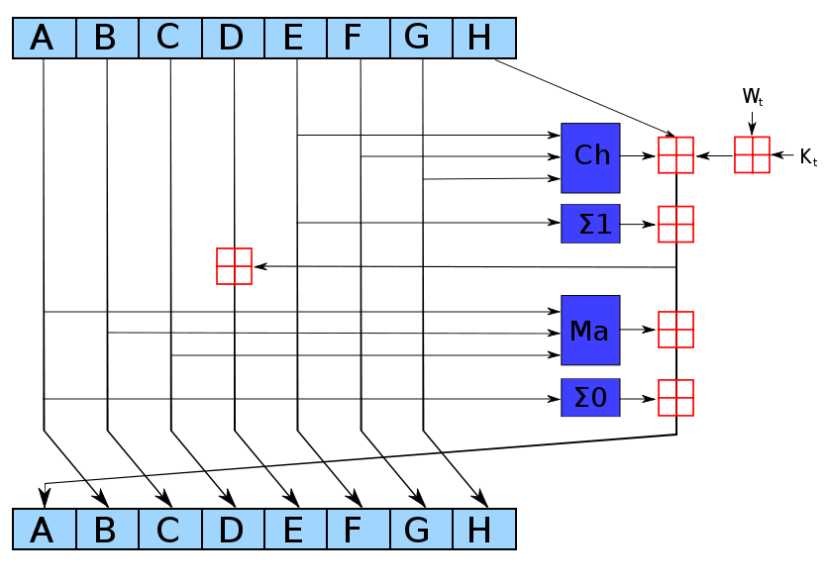
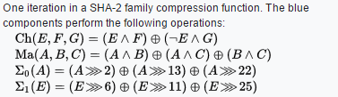
By User:kockmeyer - Own work, CC BY-SA 3.0, https://commons.wikimedia.org/w/index.php?curid=1823488

Slide 15
Hashes as IDs
Used as the ID for transactions, blocks, etc.
Proves that the data has not been changed (immutable)
Link to previous record by its hash/ID ("chain" of immutability)
ID=1234…
ID=9876…
ID=8273…
ID=3746…

Slide 16
Hashes as Proof of Work for Mining
Miner includes transactions in a new block
First transaction pays the Miner the block reward and transaction fees
The Miner then hashes of the block's contents
If there is not enough leading zeros in hash, then change something and hash again. Repeat billions of times per second per device
Nonce (a counter in the header)
Change the timestamp in the header
Add more transactions
Rearrange transactions

Slide 17
Modular Arithmetic
45:00

Slide 18
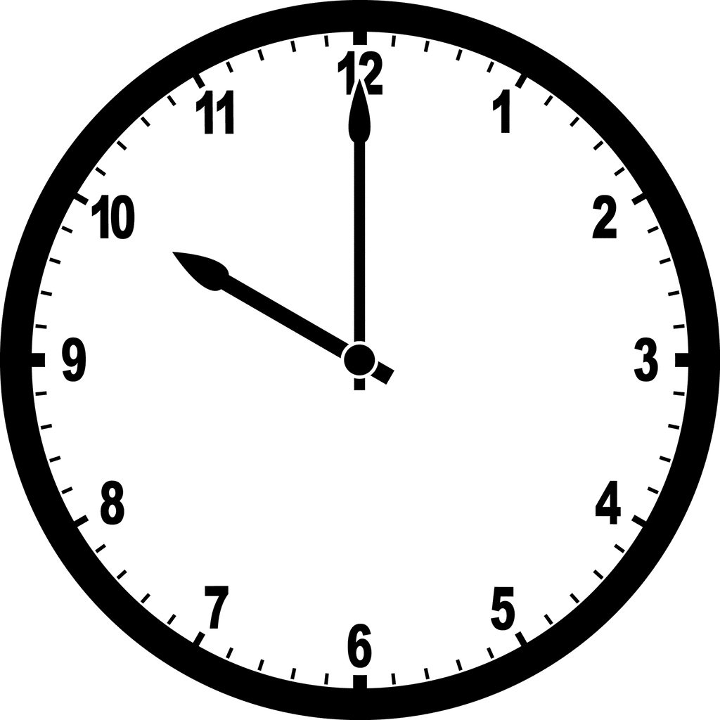
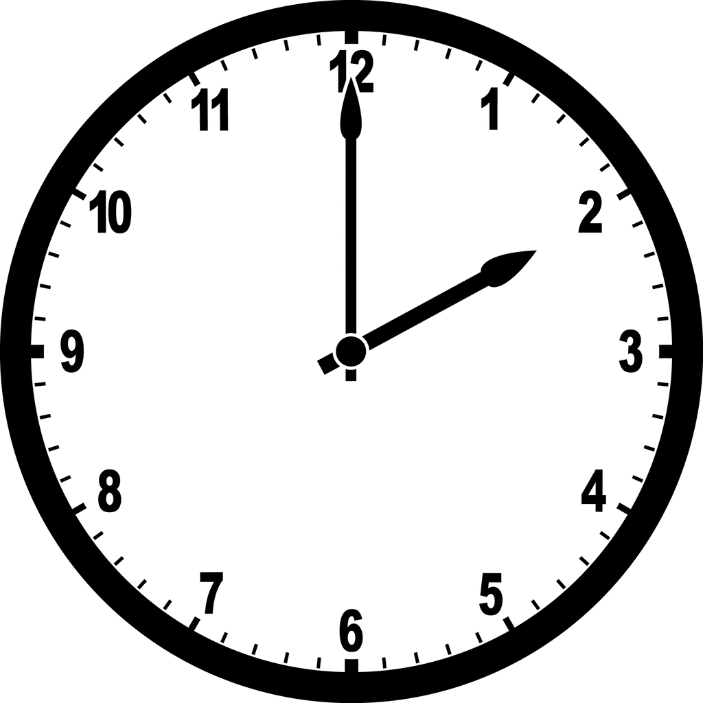
+ 4 hours =
10
+ 4
=2

Slide 19
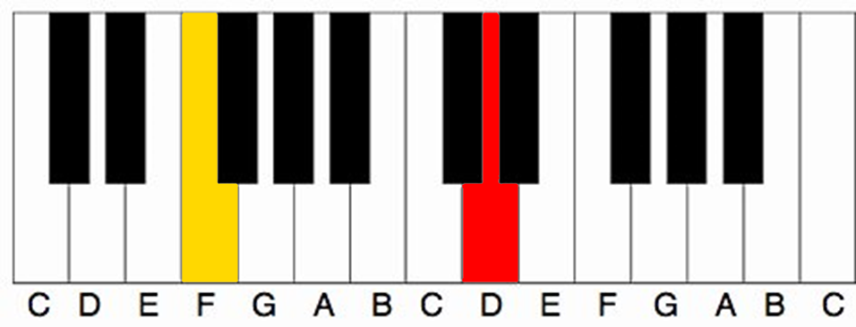
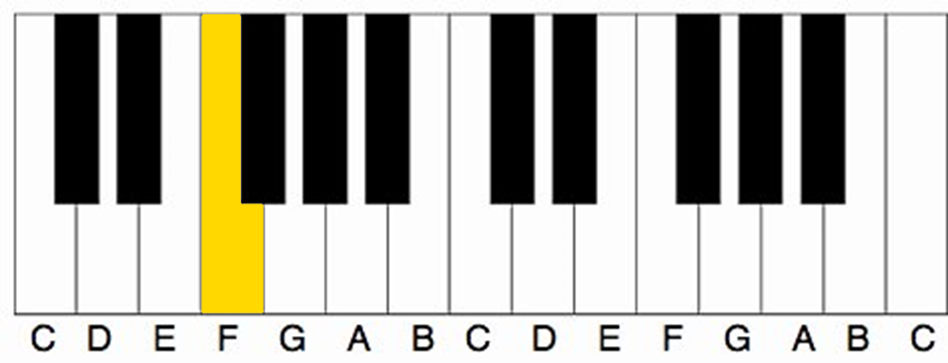
3
4
5
6
7
8
9
10
11
0
1
2
3
4
5
6
7
8
9
10
11
0
1
2
3
What note is 9 half-steps above F?
(8 + 9 = 5)

Slide 20
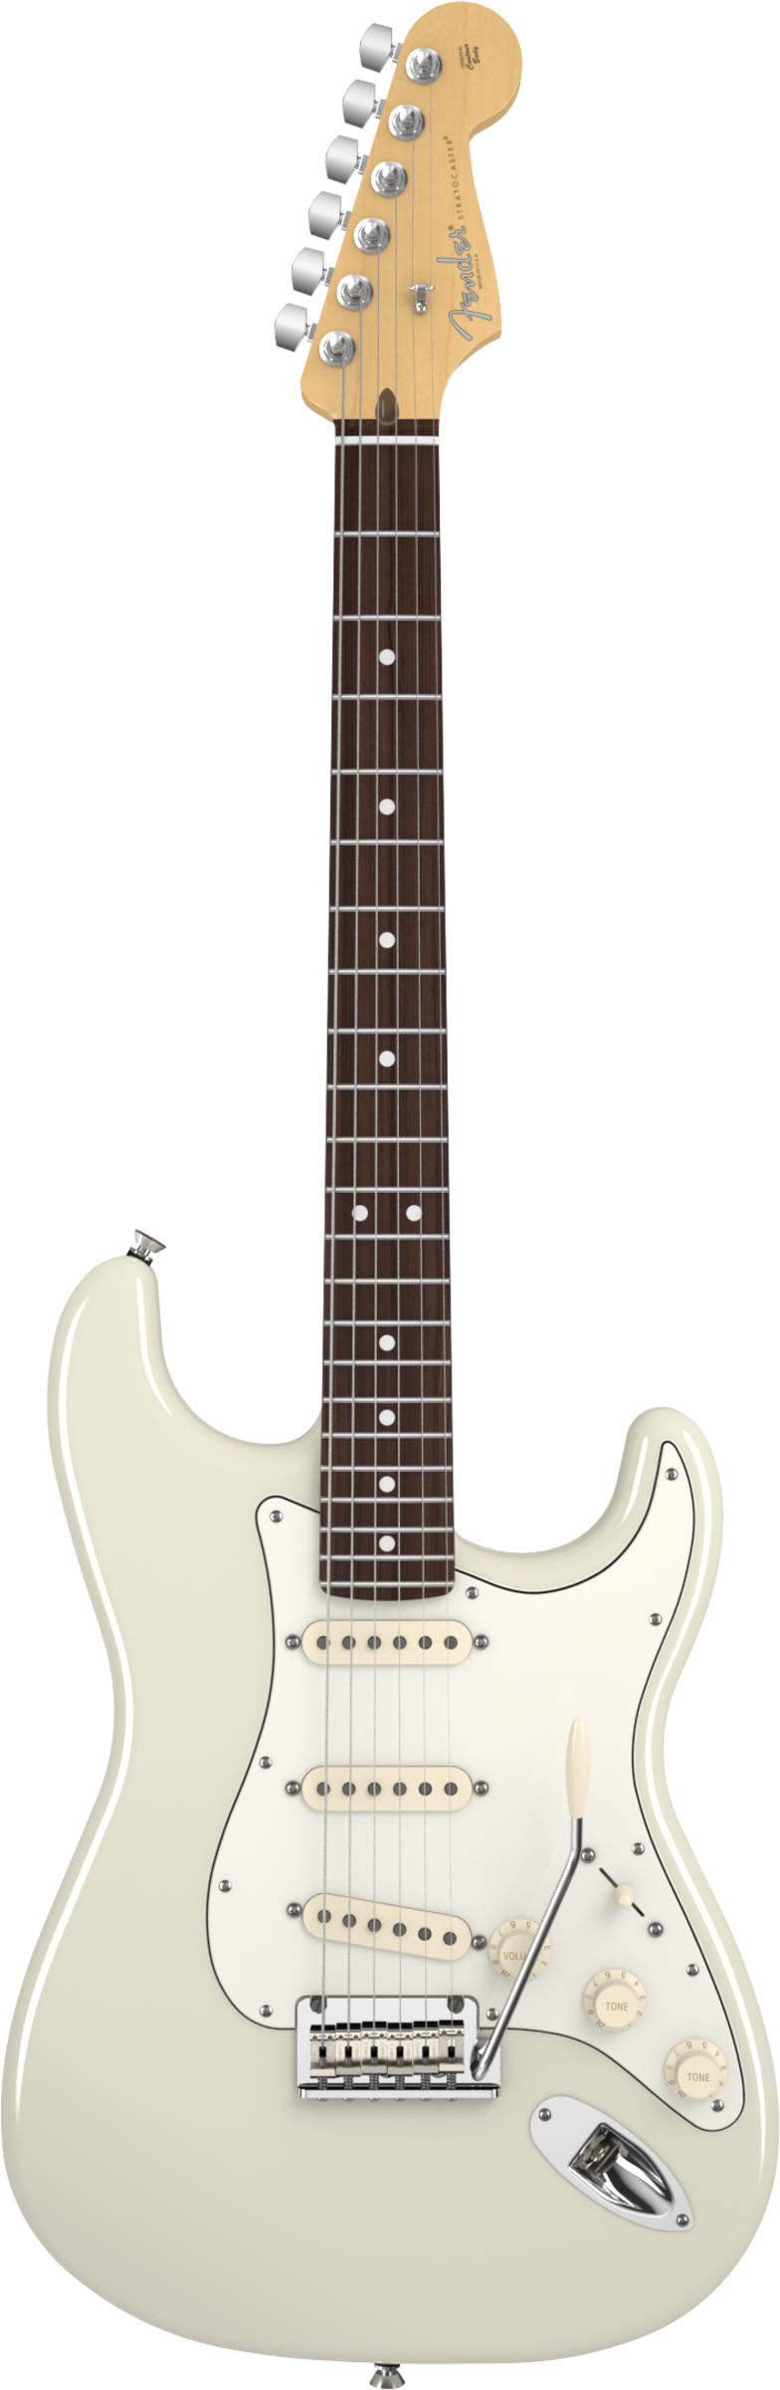
E
1
2
What note is on the 10th
fret of the 6th string?
3
4
A
5
6
7
8
D
9
10

Slide 21
Modular Arithmetic
Only integers – no fractions (remainders instead)
All calculations are done Modulo P (a prime number)
Example Multiples of 5 (mod 7):
5x1 = ?
5x2 = ?

Slide 22
Modular Arithmetic
Only integers – no fractions (remainders instead)
All calculations are done Modulo P (a prime number)
Example Multiples of 5 (mod 7):
5x1 = 5
5x2 = 10

Slide 23
Modular Arithmetic
Only integers – no fractions (remainders instead)
All calculations are done Modulo P (a prime number)
Example Multiples of 5 (mod 7):
5x1 = 5 ≡ 5 (mod 7)
5x2 = 10 ≡ 3 (mod 7)

Slide 24
Modular Arithmetic
Only integers – no fractions (remainders instead)
All calculations are done Modulo P (a prime number)
Example Multiples of 5 (mod 7):
5x1 = 5 ≡ 5 (mod 7) 5x6 = 30 ≡ 2 (mod 7)
5x2 = 10 ≡ 3 (mod 7) 5x7 = 35 ≡ 0 (mod 7)
5x3 = 15 ≡ 1 (mod 7) 5x8 = 40 ≡ 5 (mod 7)
5x4 = 20 ≡ 6 (mod 7) 5x9 = 45 ≡ 3 (mod 7)
5x5 = 25 ≡ 4 (mod 7) (the pattern is repeating now)

Slide 25
Modular Arithmetic
10x40 = 400
10x5 = 50
Example Multiples of 5 (mod 7):
5x1 = 5 ≡ 5 (mod 7) 5x6 = 30 ≡ 2 (mod 7)
5x2 = 10 ≡ 3 (mod 7) 5x7 = 35 ≡ 0 (mod 7)
5x3 = 15 ≡ 1 (mod 7) 5x8 = 40 ≡ 5 (mod 7)
5x4 = 20 ≡ 6 (mod 7) 5x9 = 45 ≡ 3 (mod 7)
5x5 = 25 ≡ 4 (mod 7) (the pattern is repeating now)

Slide 26
Modular Arithmetic
10x40 = 400 = 7x57+1
10x5 = 50 = 7x7 +1
Example Multiples of 5 (mod 7):
5x1 = 5 ≡ 5 (mod 7) 5x6 = 30 ≡ 2 (mod 7)
5x2 = 10 ≡ 3 (mod 7) 5x7 = 35 ≡ 0 (mod 7)
5x3 = 15 ≡ 1 (mod 7) 5x8 = 40 ≡ 5 (mod 7)
5x4 = 20 ≡ 6 (mod 7) 5x9 = 45 ≡ 3 (mod 7)
5x5 = 25 ≡ 4 (mod 7) (the pattern is repeating now)

Slide 27
Modular Arithmetic
10x40 = 400 = 7x57+1 ≡ 3x5 = 15 ≡ 1 (mod 7)
10x5 = 50 = 7x7 +1 ≡ 3x5 = 15 ≡ 1 (mod 7)
Example Multiples of 5 (mod 7):
5x1 = 5 ≡ 5 (mod 7) 5x6 = 30 ≡ 2 (mod 7)
5x2 = 10 ≡ 3 (mod 7) 5x7 = 35 ≡ 0 (mod 7)
5x3 = 15 ≡ 1 (mod 7) 5x8 = 40 ≡ 5 (mod 7)
5x4 = 20 ≡ 6 (mod 7) 5x9 = 45 ≡ 3 (mod 7)
5x5 = 25 ≡ 4 (mod 7) (the pattern is repeating now)

Slide 28
Multiplication Modulo 7 (Finite Field F₇)
 | 1 | 2 | 3 | 4 | 5 | 6
1 | 1 | 2 | 3 | 4 | 5 | 6
2 | 2 | 4 | 6 | 1 | 3 | 5
3 | 3 | 6 | 2 | 5 | 1 | 4
4 | 4 | 1 | 5 | 2 | 6 | 3
5 | 5 | 3 | 1 | 6 | 4 | 2
6 | 6 | 5 | 4 | 3 | 2 | 1

Slide 29
What about Division?
40:00

Slide 30
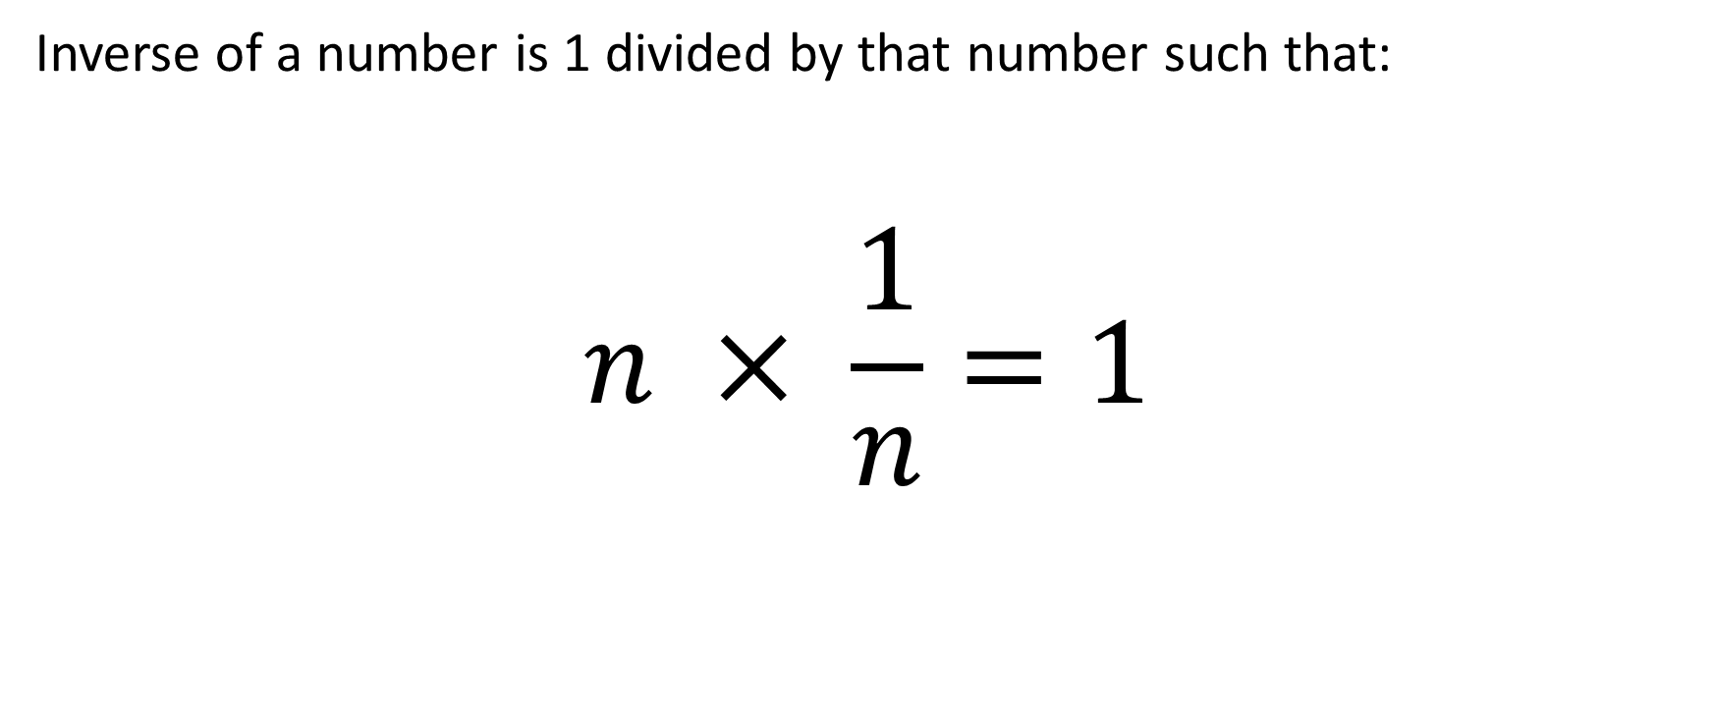
Division
Inverse of a number is 1 divided by that number such that:
$$n × \frac{1}{n}=1$$

Slide 31
Multiplication Modulo 7 (Finite Field F₇)
 | 1 | 2 | 3 | 4 | 5 | 6
1 | 1 | 2 | 3 | 4 | 5 | 6
2 | 2 | 4 | 6 | 1 | 3 | 5
3 | 3 | 6 | 2 | 5 | 1 | 4
4 | 4 | 1 | 5 | 2 | 6 | 3
5 | 5 | 3 | 1 | 6 | 4 | 2
6 | 6 | 5 | 4 | 3 | 2 | 1

Slide 32
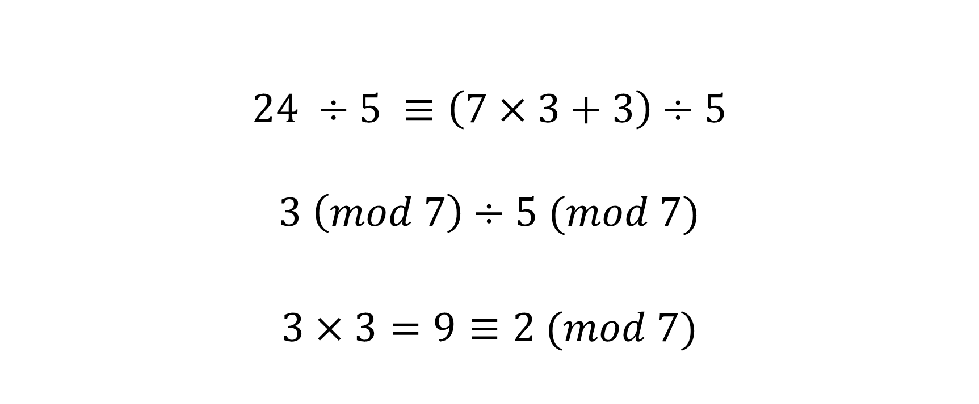
What is 24 ÷ 5 in F₇?
$$24 ÷5 ≡\left(7×3+3\right)÷5$$
$$3 \left(mod 7\right)÷5 (mod 7)$$
$3×3=9≡2 (mod 7)$

Slide 33
Elliptic Curves
35:00

Slide 34
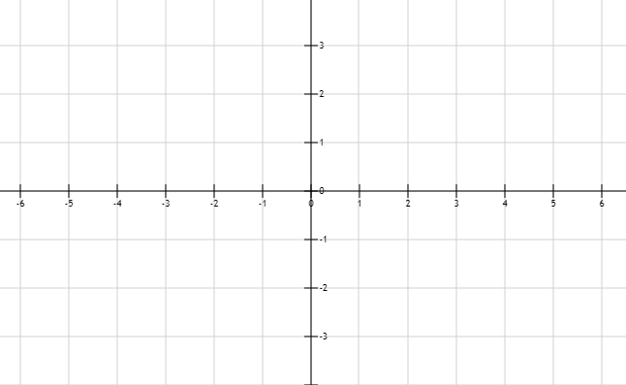
+y
(3,2)
-x
+x
-y

Slide 35
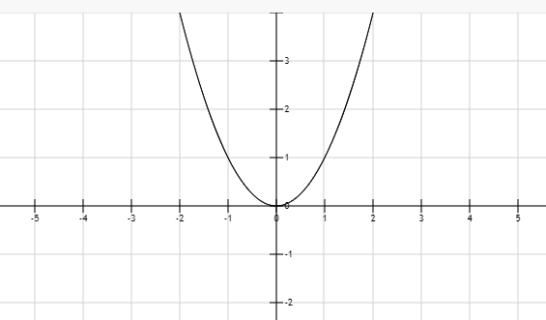
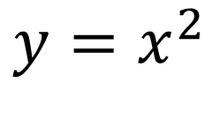
$$y=x^{2}$$

Slide 36
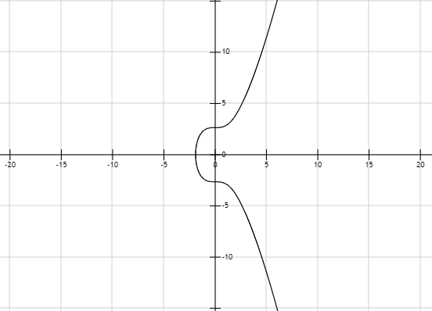
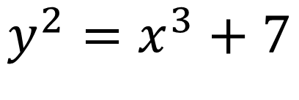
$$y^{2}=x^{3}+7$$

Slide 37
Elliptic Curve Arithmetic
30:00

Slide 38
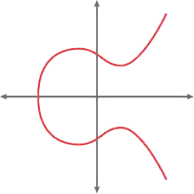
Elliptic Curve Addition
Q
P
P + Q

Slide 39
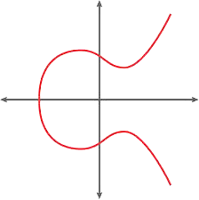
Elliptic Curve Point Doubling
P
2P

Slide 40
Elliptic Curve Multiplication
4P
2P

Slide 41
Binary Multiplication
Double and Add algorithm:
Iterate each bit from 2^{M} to 2⁰
Double the accumulator with each iteration
If bit = 1, then add the point to accumulator

Slide 42
Binary Multiplication
Figure out 99*P (99 = 1100011 in binary):
Iteration | Bit | Accumulator
1 | 1 | P
2 | 1 | 2(P)+P
3 | 0 | 2(2(P)+P)
4 | 0 | 2(2(2(P)+P))
5 | 0 | 2(2(2(2(P)+P)))
6 | 1 | 2(2(2(2(2(P)+P))))+P
7 | 1 | 2(2(2(2(2(2(P)+P))))+P)+P

Slide 43
Affine Points
(Pronounced like "It's a fine day outside")
25:00

Slide 44
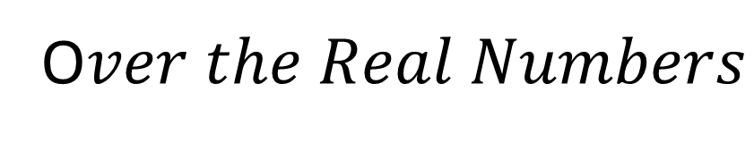
O$ver the Real Numbers$

Slide 45
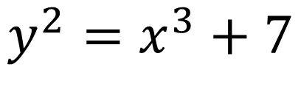
But, Cryptography Requires Integers
X and Y must be integers
Fractional points are dropped (e.g., x=2.5)
Modular field is introduced (e.g., (mod P))
Not every X-coordinate will result in a valid point!
$$y^{2}=x^{3}+7$$
x³ + 7 must be a Quadratic Residue (mod P) for it to be a valid point

Slide 46
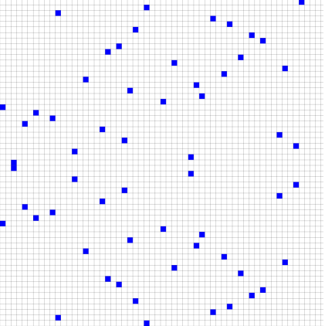
F₅₉

Slide 47
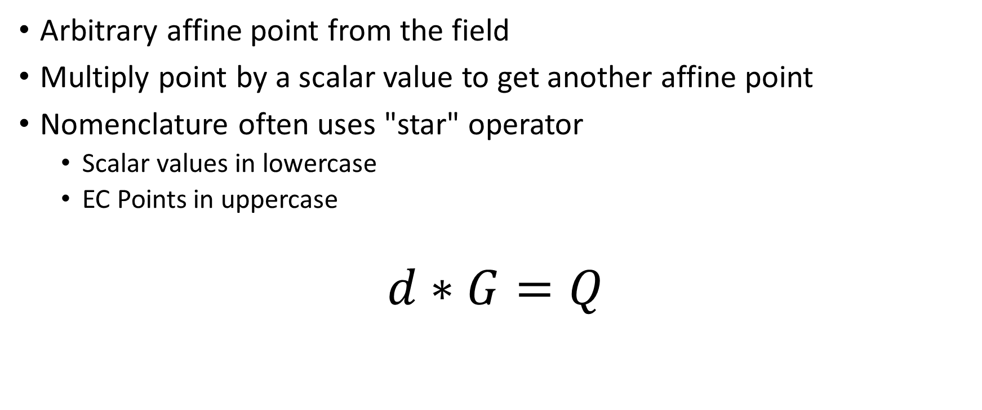
Generator
Arbitrary affine point from the field
Multiply point by a scalar value to get another affine point
Nomenclature often uses "star" operator
Scalar values in lowercase
EC Points in uppercase
$$d∗G=Q$$

Slide 48
F₅₉
G

Slide 49
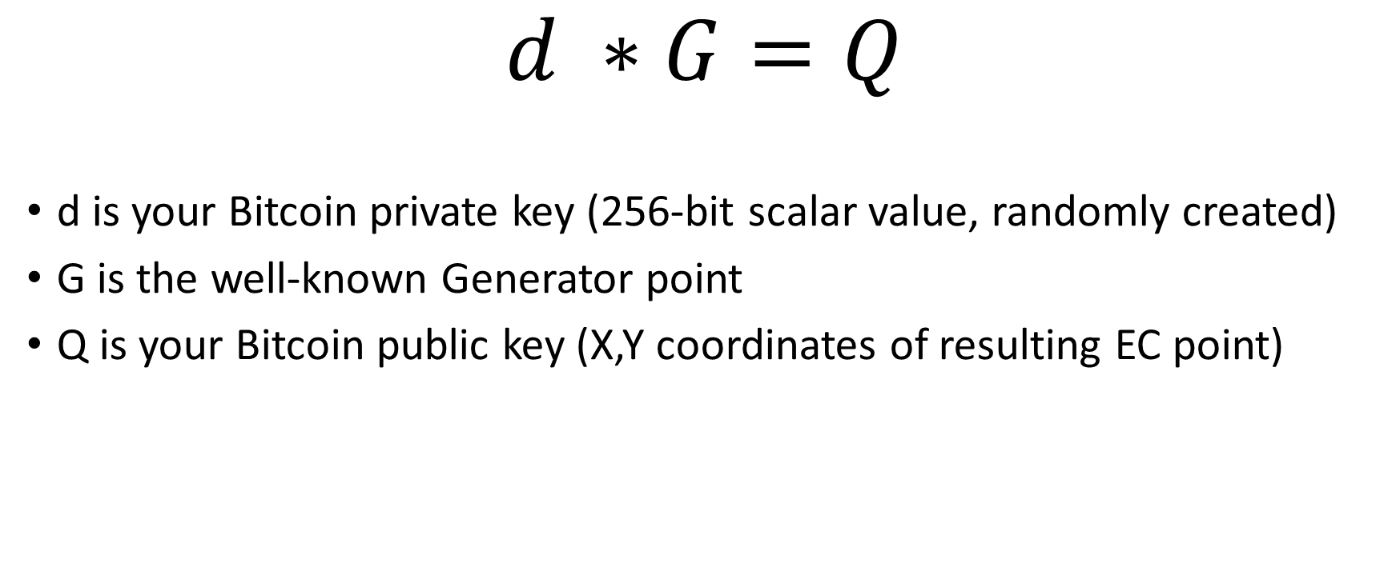
Applying EC to Bitcoin
$$d ∗G=Q$$
d is your Bitcoin private key (256-bit scalar value, randomly created)
G is the well-known Generator point
Q is your Bitcoin public key (X,Y coordinates of resulting EC point)

Slide 50
All Must Agree Upon Which Curve to Use
secp256k1
Standards for Efficient Cryptography (SEC) (Certicom Research, http://www.secg.org/collateral/sec2_final.pdf).
256-bit Prime Modulus
A Koblitz Curve (designed for efficiency)

Slide 51
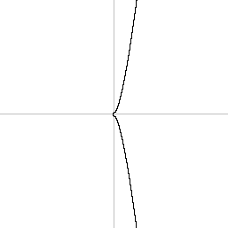
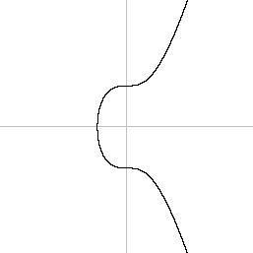
Secp256k1 Curve: y² = x³ + 0x + 7
A
B
-128
128
-8
8

Slide 52
Other secp256k1 Domain Parameters
Field Fp
P: FFFFFFFFFFFFFFFFFFFFFFFFFFFFFFFFFFFFFFFFFFFFFFFFFFFFFFFEFFFFFC2F
Base Point (Generator) G
X: 79BE667EF9DCBBAC55A06295CE870B07029BFCDB2DCE28D959F2815B16F81798
Y: 483ADA7726A3C4655DA4FBFC0E1108A8FD17B448A68554199C47D08FFB10D4B8
Order N of G:
N: FFFFFFFFFFFFFFFFFFFFFFFFFFFFFFFEBAAEDCE6AF48A03BBFD25E8CD0364141

Slide 53
Elliptic Curve Discrete Log Problem
20:00

Slide 54

Page 12
Page 9823
Page 2975
Page 1
Page 42

Slide 55
Page 87
200 sheets up

Slide 56
Page 33
??? sheets up

Slide 57
1 meter = 6666 sheets (13-bit number)

Slide 58
2 meter = 13332 sheets (14-bit number)

Slide 59
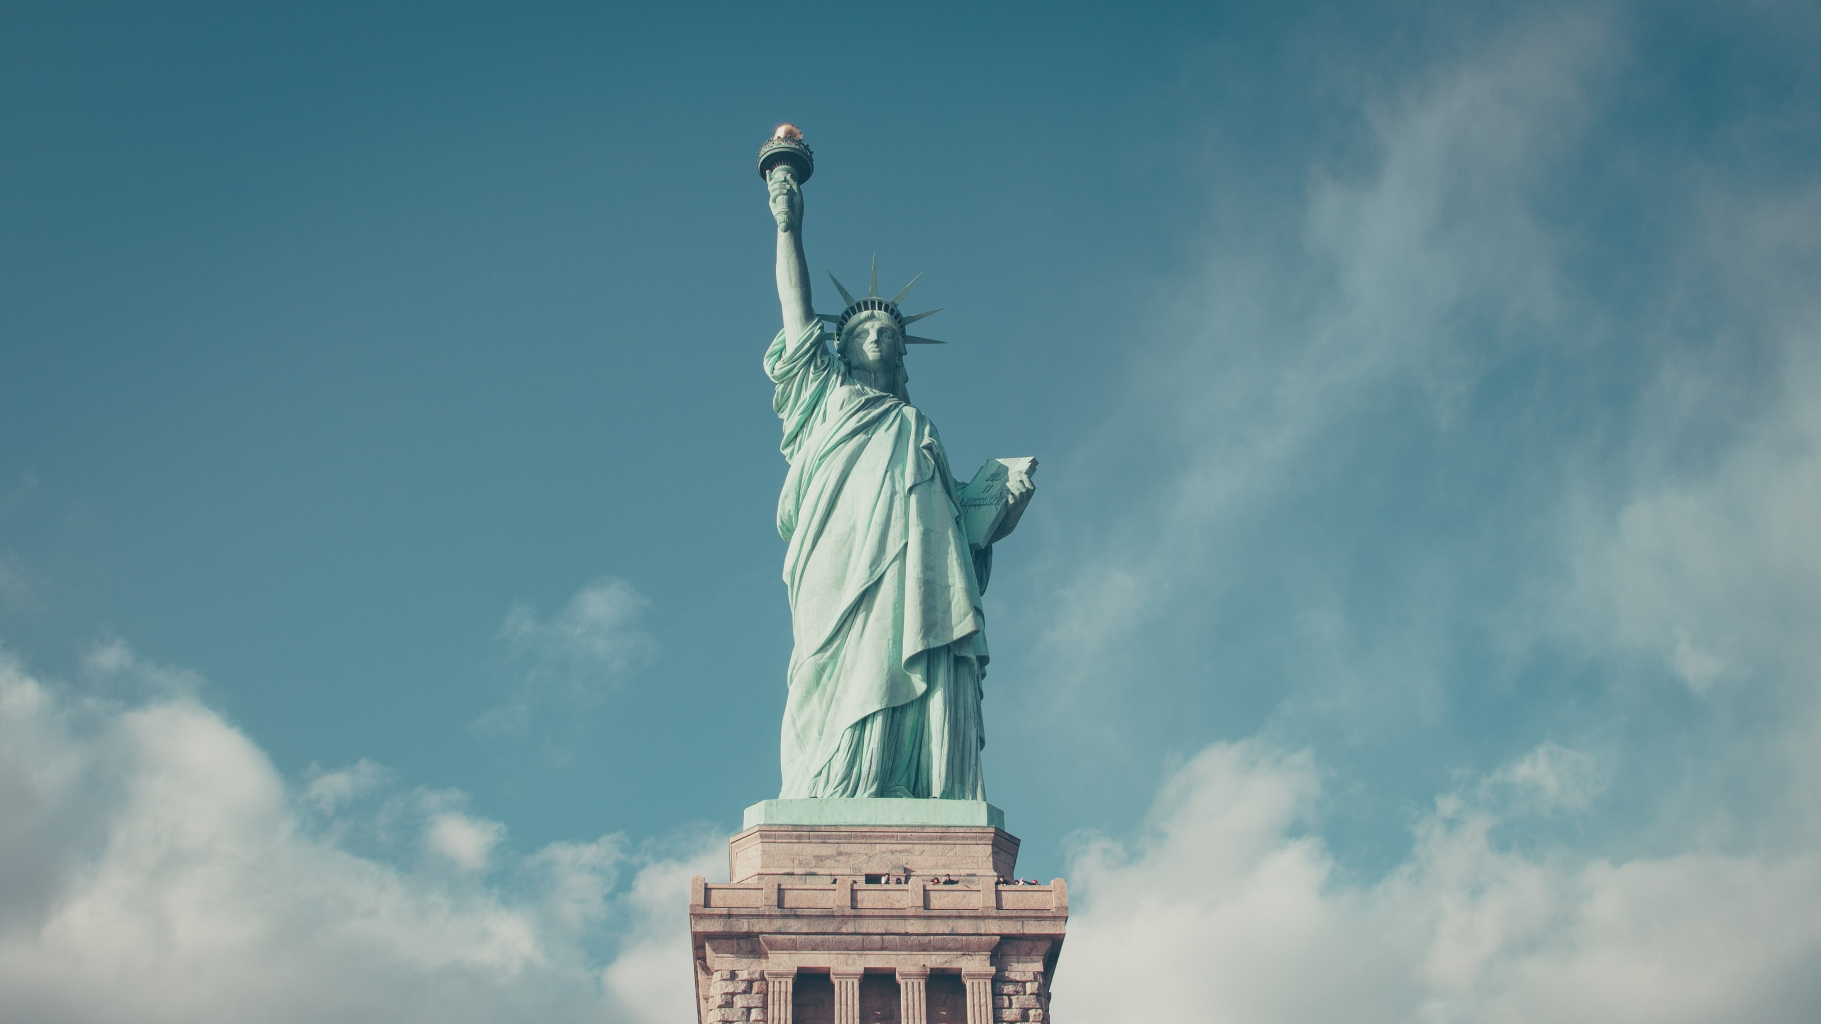
93 meter = 619938 sheets (20-bit number)

Slide 60
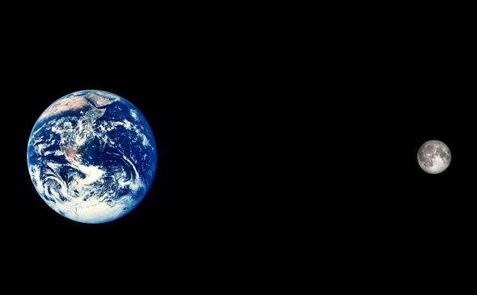
384,000 km
2,559,744,000,000 sheets
(42-bit number)

Slide 61
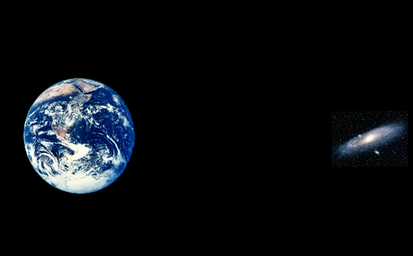
2.537 million light years
159,996,485,418,000,000,000,000,000 sheets
(88-bit number)

Slide 62
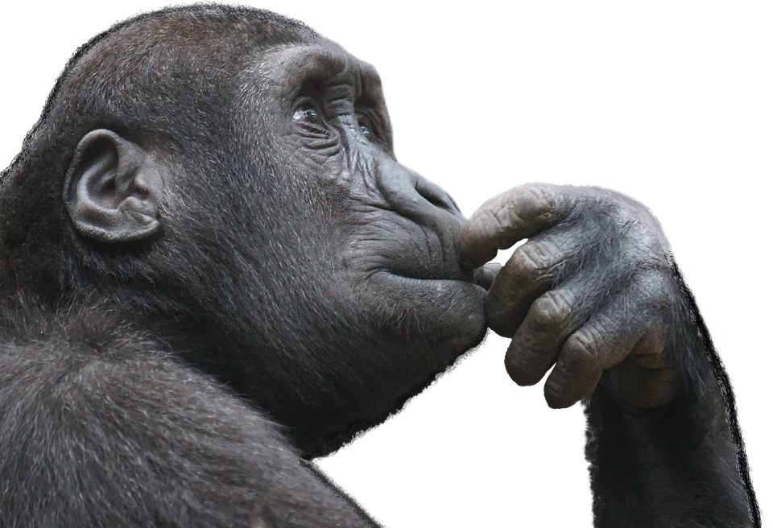
Bitcoin uses a 256-bit number…

Slide 63
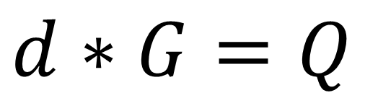
$$d∗G=Q$$
Public Key (Q)
Private Key (d)

Slide 64
Attacks on ECDLP
15:00

Slide 65
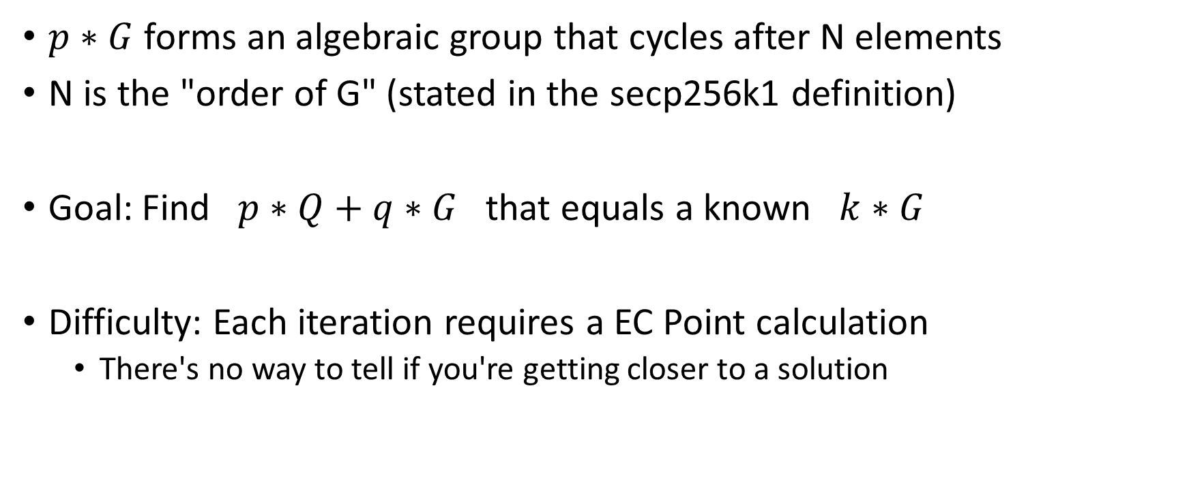
Attacks Focus on the Underlying Group
$p∗G$ forms an algebraic group that cycles after N elements
N is the "order of G" (stated in the secp256k1 definition)
Goal: Find $p∗Q+q∗G$ that equals a known $k∗G$
Difficulty: Each iteration requires a EC Point calculation
There's no way to tell if you're getting closer to a solution

Slide 66
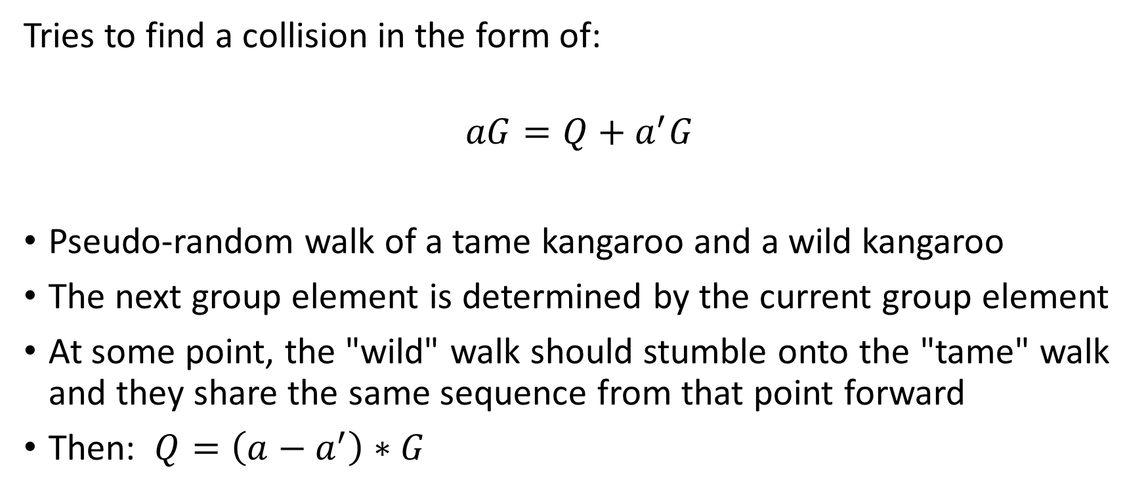
Pollard’s Kangaroo (Lambda) Algorithm
Tries to find a collision in the form of:
$$aG=Q+a^{′}G$$
Pseudo-random walk of a tame kangaroo and a wild kangaroo
The next group element is determined by the current group element
At some point, the "wild" walk should stumble onto the "tame" walk and they share the same sequence from that point forward
Then: $Q=\left(a−a^{′}\right)∗G$

Slide 67

Pollard’s Kangaroo (Lambda) Algorithm
A distinguished point (a.k.a., a "Trap")
Wild Kangaroo We only know it's public key
Tame Kangaroo
We know everything about it

Slide 68
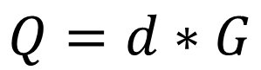
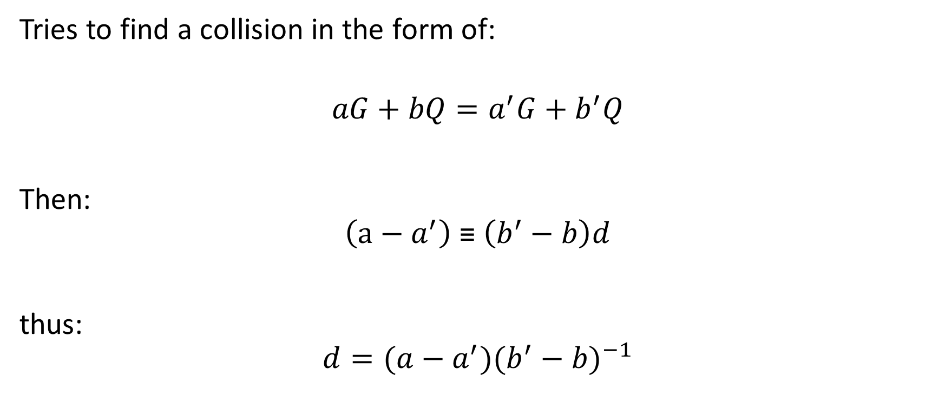
Pollard’s Rho Algorithm
Tries to find a collision in the form of:
$$aG+bQ=a^{′}G+b^{′}Q$$
Then:
$$\left(a−a^{′}\right) \text{≡} \left(b^{′}−b\right)d$$
thus:
$$d=(a−a^{′}){(b^{′}−b)}^{−1}$$
$$Q=d∗G$$

Slide 69
Pollard’s Rho Algorithm
Distinguished Point

Slide 70
Records
December 2016, 117-bit ECDLP on sect113r2 curve
Used optimized FPGA implementation of parallel version of Pollard Rho
6 months on cluster of 64 to 576 FPGAs in parallel
2^60 iteration steps
However, this record is not the secp256k1 curve. Each curve has advantages and disadvantages (i.e., certain optimizations may exist)
There is no known successful attacks on Bitcoin… but those probably wouldn't be published academically anyways. ☺

Slide 71
Bitcoin Addresses
10:00

Slide 72
Why use Addresses?
Mitigate risk of someone solving ECDLP (or using weak keys):
Given your Public key, derive the Private Key
Addresses are based on hashing a Public Key
The actual Public Key is only revealed when a Transaction's payment is claimed
A best practice for any Cryptocurrency is to use a different key for each transaction, since the Public Key is revealed in the end

Slide 73
What is a Bitcoin address?
1JHYG91McMgviqDDLSXq1TsPvZB7LYxV1s
Base58 Encoding of Version Byte + RIPEMD160 HASH of Public Key + checksum
Base58
Uppercase and Lowercase Letters plus numbers, except for O, 0, I, l

Slide 74
What is a Bitcoin address?
1JHYG91McMgviqDDLSXq1TsPvZB7LYxV1s
Base58 Encoding of Version Byte + RIPEMD160 HASH of Public Key + checksum
Decoded Base58
00 bd9ae39ae11fd05642fe51c0ae15191fb1cb0984 d03b970a
Version Byte
00 Bitcoin Main Network Pubkey Hash ('1' addresses) 6F Bitcoin Test Network Pubkey Hash ('m' or 'n' addresses)
1E Dogecoin Pubkey Hash ('D' addresses)

Slide 75
What is a Bitcoin address?
1JHYG91McMgviqDDLSXq1TsPvZB7LYxV1s
Base58 Encoding of Version Byte + RIPEMD160 HASH of Public Key + checksum
RIPEMD160 Hash
bd9ae39ae11fd05642fe51c0ae15191fb1cb0984 Public Key: 04
3bfd3e5fb4483121be089c604d67c3ee0fe5741584b6976b152b50d497216d71 3f245e78311368b0ab64936cb99e5b9778d416cc1bfc60adaf9f8ad8eb3b4021

Slide 76
What is a Bitcoin address?
1JHYG91McMgviqDDLSXq1TsPvZB7LYxV1s
Base58 Encoding of Version Byte + RIPEMD160 HASH of Public Key + checksum
Checksum
Double-SHA256 Hash the Version Byte + RIPEMD160 Hash Pass 1: c3996bae3cbcb0ba0d7b60bf8c17f7e3aef33487caca2e1a51a7e2bc34c12b65
Pass 2: d03b970aa8fd63c428f1c33b8a31a46a2b5c0c525cb35208fd8bb2dc4f8fe71b

Slide 77
ECDSA Elliptic Curve Digital Signature Algorithm
5:00

Slide 78
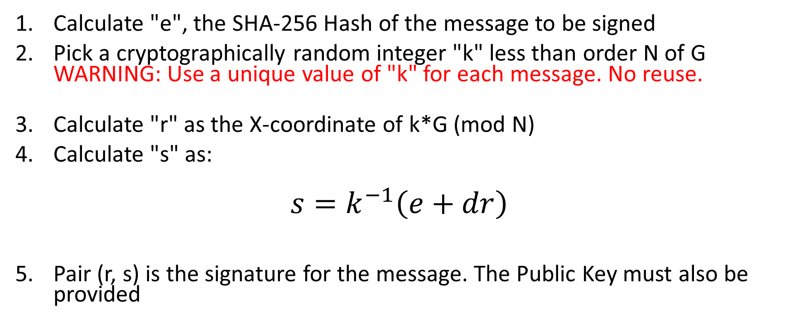
Elliptic Curve Digital Signature Algorithm
Calculate "e", the SHA-256 Hash of the message to be signed
Pick a cryptographically random integer "k" less than order N of G WARNING: Use a unique value of "k" for each message. No reuse.
Calculate "r" as the X-coordinate of k*G (mod N)
Calculate "s" as:
$$s=k^{−1}\left(e+dr\right)$$
Pair (r, s) is the signature for the message. The Public Key must also be provided
Secret 1-time number
Private Key

Slide 79
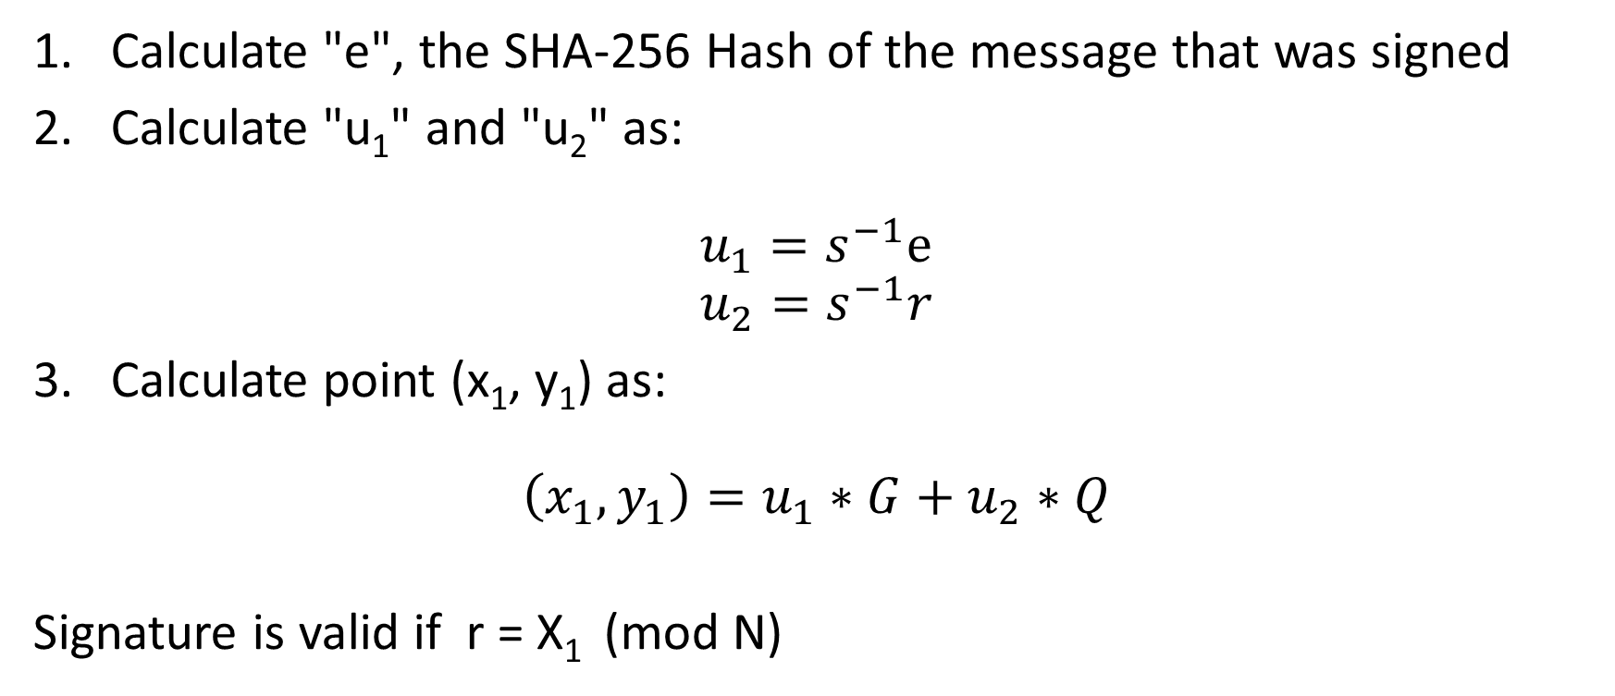
Signature Verification
Calculate "e", the SHA-256 Hash of the message that was signed
Calculate "u₁" and "u₂" as:
$$u_{1}=s^{−1}e \\ u_{2}=s^{−1}r$$
Calculate point (x₁, y₁) as:
$$\left(x_{1}, y_{1}\right)=u_{1}∗G+u_{2}∗Q$$
Signature is valid if r = X₁ (mod N)
Public Key

Slide 80
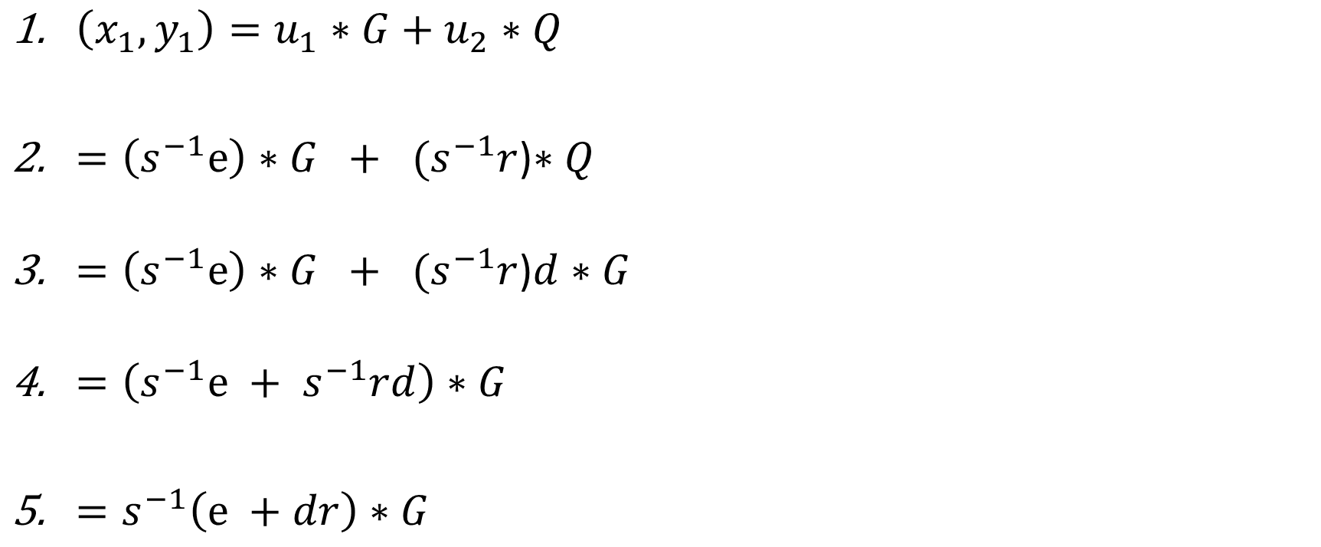
Why Does That Work?
$\left(x_{1}, y_{1}\right)=u_{1}∗G+u_{2}∗Q$
$=\left(s^{−1}e\right)∗G + { (s}^{−1}r$)$∗Q$
$=\left(s^{−1}e\right)∗G + { (s}^{−1}r$)$d∗G$
$=\left(s^{−1}e +{ s}^{−1}rd\right)∗G$
$=s^{−1}\left(e +dr\right)∗G$

Slide 81
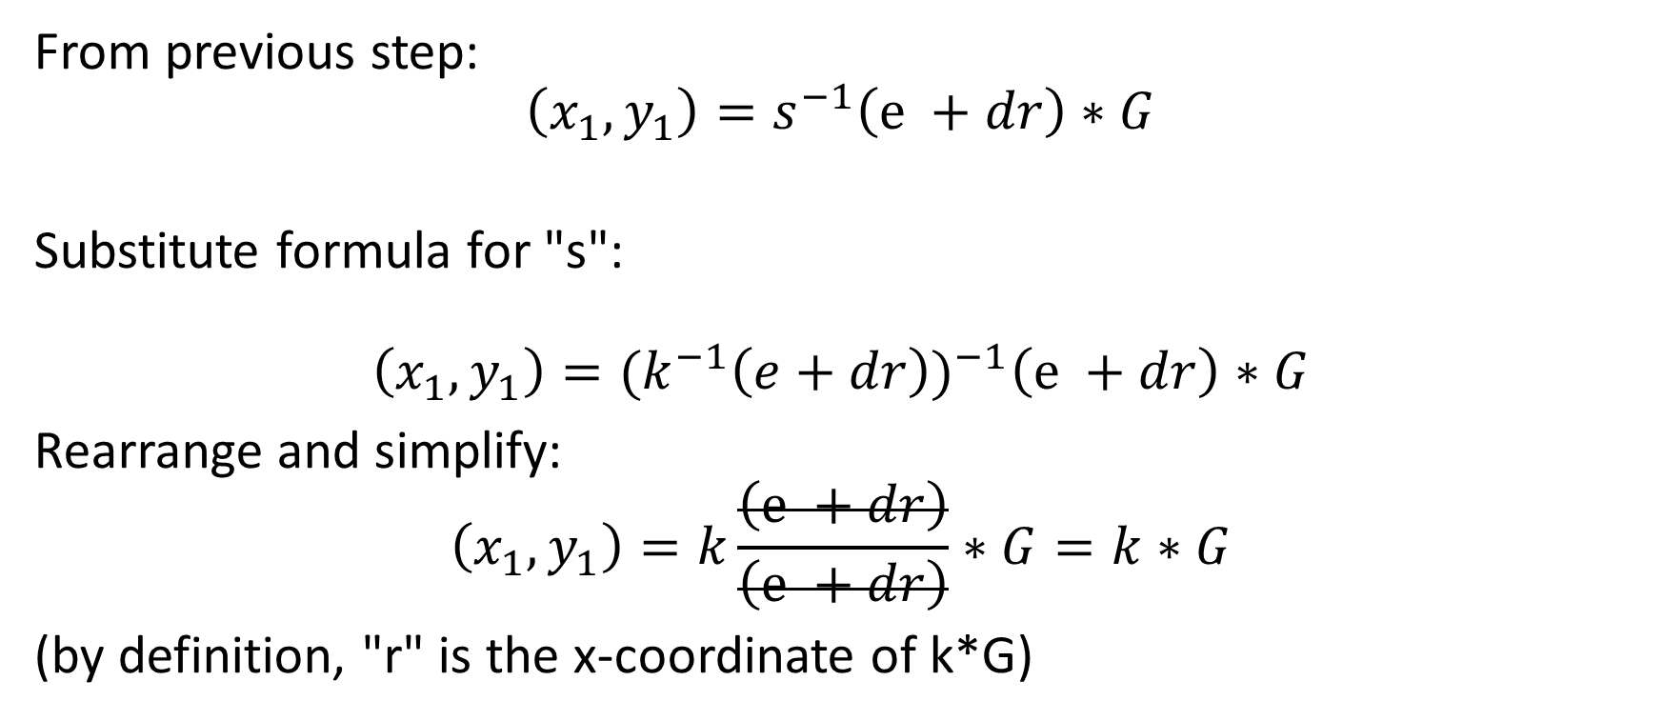
Why Does That Work?
From previous step: $$\left(x_{1}, y_{1}\right)=s^{−1}\left(e +dr\right)∗G$$
Substitute formula for "s":
$$\left(x_{1}, y_{1}\right)={{(k}^{−1}\left(e+dr\right))}^{−1}\left(e +dr\right)∗G$$
Rearrange and simplify:
$$\left(x_{1}, y_{1}\right)=k\frac{\left(e +dr\right)}{\left(e +dr\right)}∗G=k∗G$$
(by definition, "r" is the x-coordinate of k*G)

Slide 82
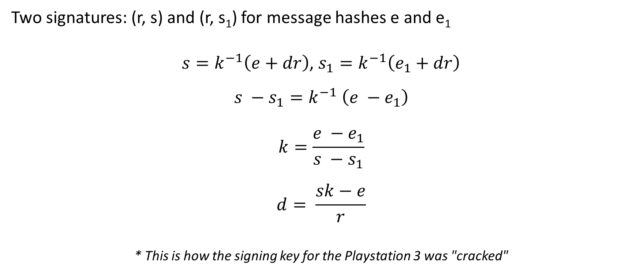
What if "k" is reused for multiple signatures?
Two signatures: (r, s) and (r, s₁) for message hashes e and e₁
$s=k^{−1}\left(e+dr\right)$, $s_{1}=k^{−1}\left(e_{1}+dr\right)$
$$s −s_{1}=k^{−1} \left(e −e_{1}\right)$$
$$k=\frac{e −e_{1}}{s −s_{1}}$$
$$d= \frac{sk−e}{r}$$
* This is how the signing key for the Playstation 3 was "cracked"
And once we know k…

Slide 83
That's Probably Enough for Now!
0:00

Slide 84


Contact Information
Jason Follas
Quicken Loans
jasonfollas@quickenloans.com
Twitter: @jfollas
This presentation and code can be found here: https://github.com/jfollas/bitcoin-math
#10
#1

